Slide 1

6CS005 High Performance
Computing
Lecture 8
GPGPU Computing With CUDA

Slide 2
Overview
GPU
Computing Architecture
CPU vs GPU
GPGPU
Way to Accelerate Applications
CUDA
NVIDIA GPU Architecture
Simple Processing Flow
Vector Addition Example ( CPU and GPU)
CUDA Memories
CUDA Execution Model
Grid Block Thread
CUDA Compilation

Slide 3
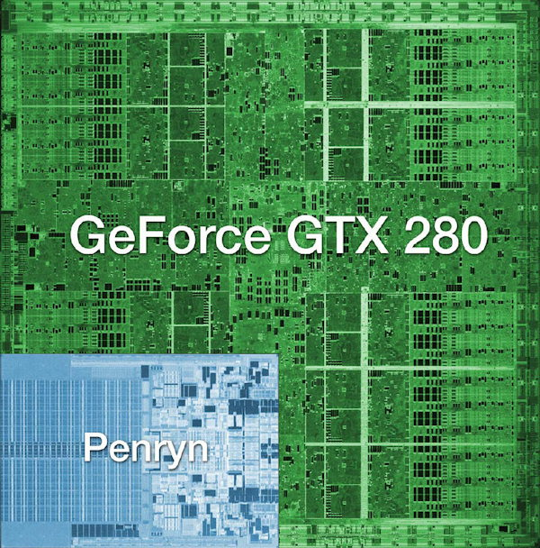
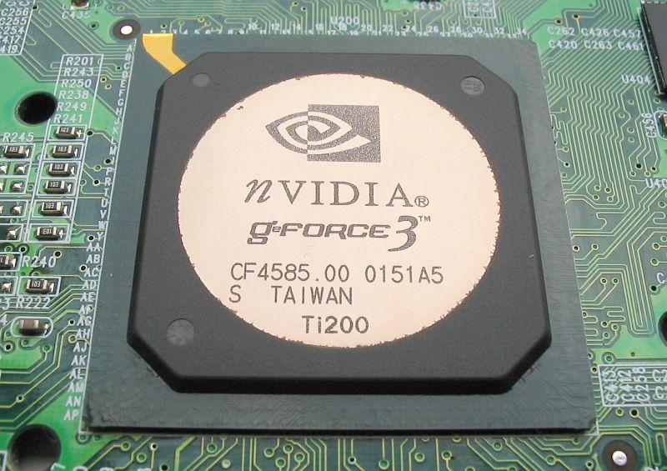
GPU
GPU (graphics processing unit ) is a RISC specialized processor that offloads 3D graphics rendering from microprocessor.
GPUs are mainly used in embedded systems, mobile phones, personal computers, workstations and game consoles.
Highly parallel, highly multithreaded multiprocessor optimized for
graphic computing and other applications
Fig.3: Nvidia GPU Chips

Slide 4
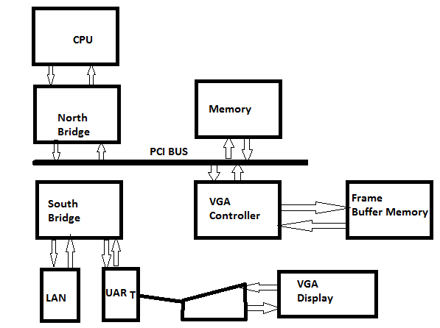
Historical PC
Fig.1: Historical PC. VGA controller drives graphics display from frame buffer memory.

Slide 5
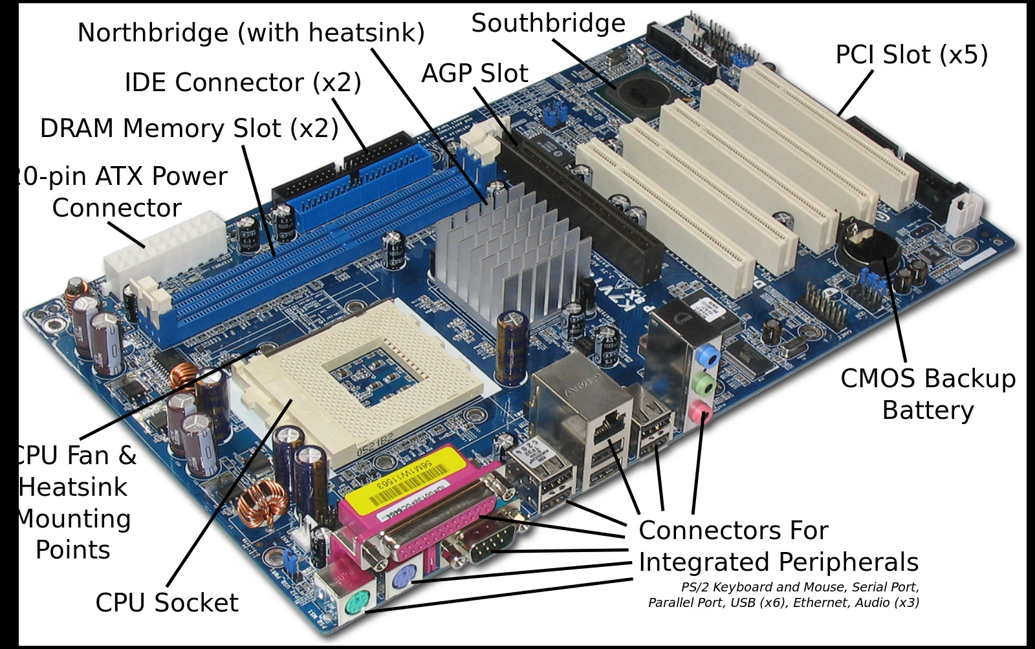
Modern Day PC
Fig.1: Modern Day Computer

Slide 6
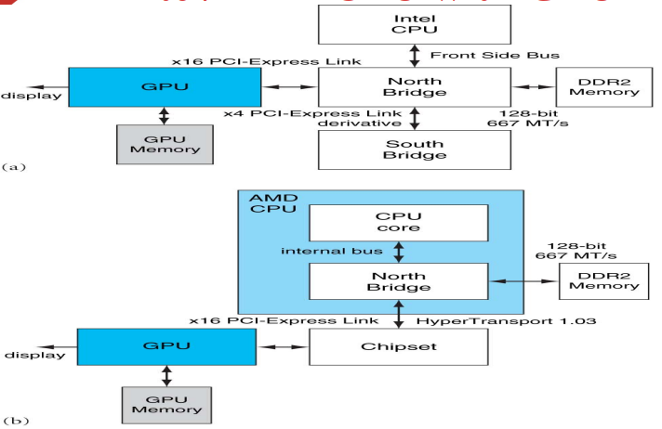
Modern Day PC
Fig.2: Contemporary PCs with Intel and AMD CPUs

Slide 7
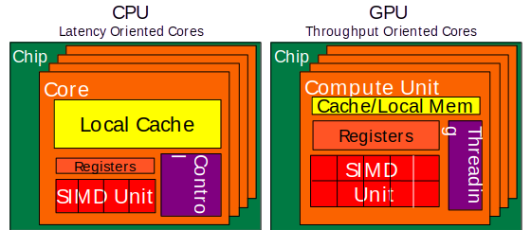
CPU and GPU are designed very differently

Slide 8
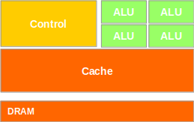

CPUs: Latency Oriented Design
– Powerful ALU
– Reduced operation latency Cache
– Large caches
– Convert long latency memory
accesses to short latency cache
Accesses
– Sophisticated control DRAM
– Branch prediction for reduced
branch latency
– Data forwarding for reduced data
latency

Slide 9
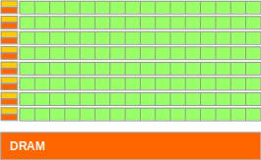
GPUs: Throughput Oriented Design
-Small caches
- To boost memory throughput
- Simple control
- No branch prediction
- No data forwarding
- Energy efficient ALUs
- Many, long latency but heavily pipelined for high throughput
- Require massive number of threads to tolerate latencies
- Threading logic
- Thread state

Slide 10
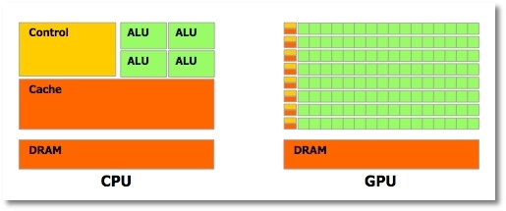
Winning Applications Use Both CPU and GPU
CPUs for sequential parts where latency matters
CPUs can be 10X+ faster than GPUs for sequential code
GPUs for parallel parts where throughput wins
GPUs can be 10X+ faster than CPUs for parallel code

Slide 11

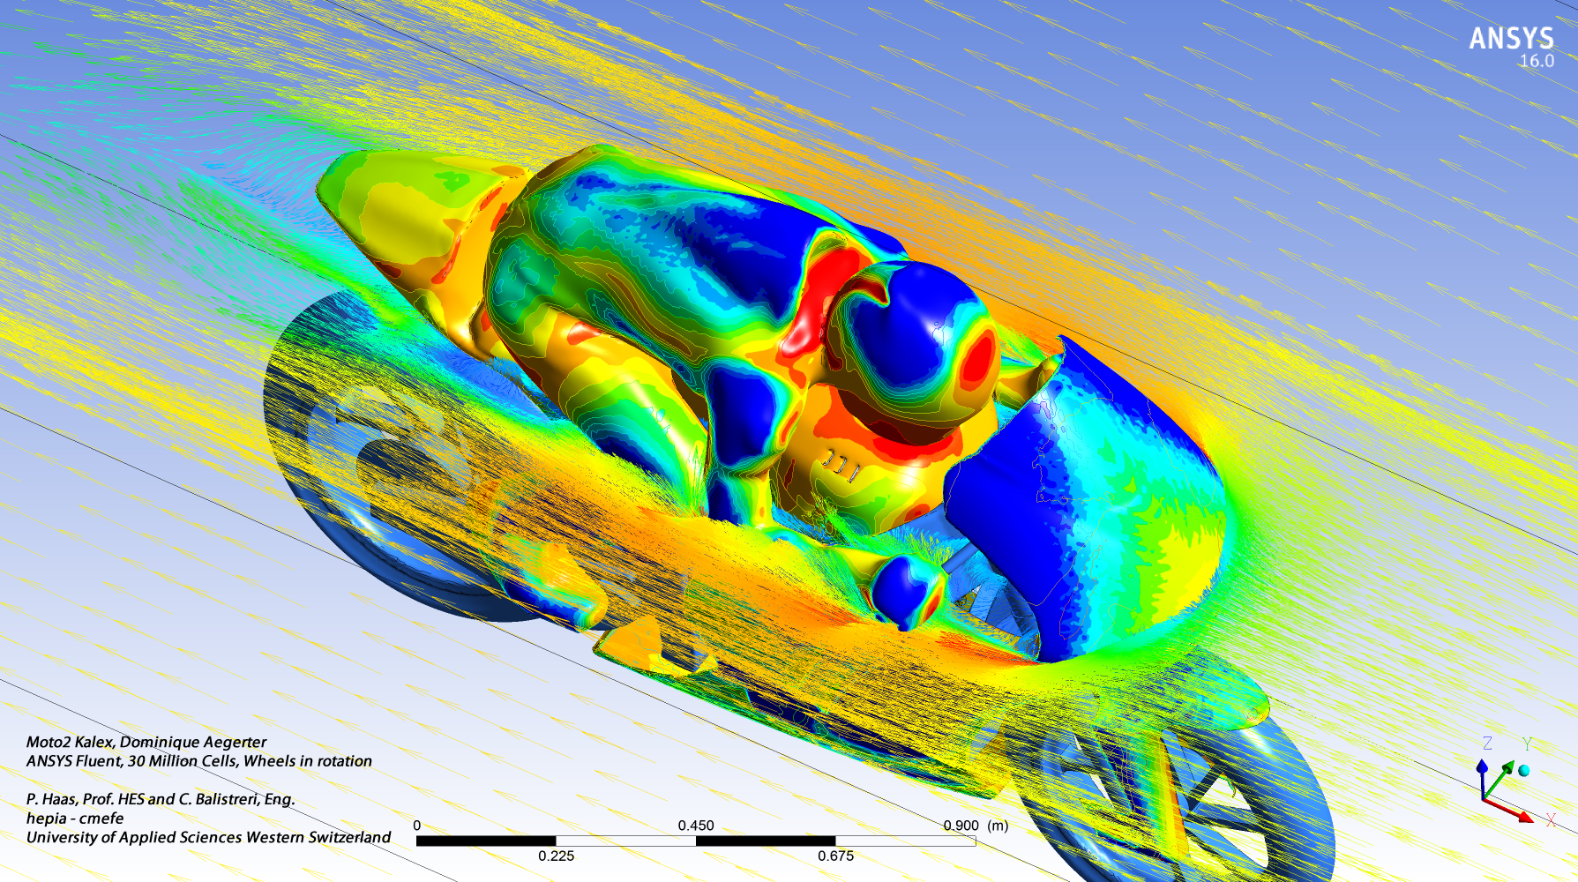
What is GPGPU computing ?
General Purpose computation using GPU in applications other than 3D graphics
GPU accelerates critical path of application
Data parallel algorithms leverage GPU attributes
Large data arrays, streaming throughput
Fine-grain SIMD parallelism
Low-latency floating point (FP) computation
Applications –
Game effects (FX) physics, image processing
Physical modeling, computational engineering, matrix algebra, convolution, correlation, sorting

Slide 12
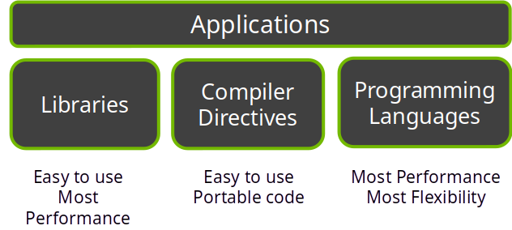
3 Ways to Accelerate Applications

Slide 13
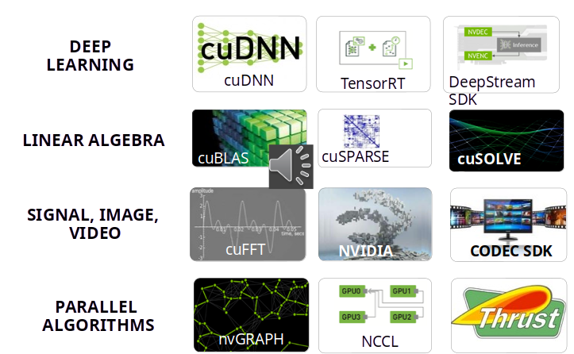
NVIDIA GPU Accelerated Libraries

Slide 14
Compiler Directives: Easy, Portable Acceleration
OpenACC
Compiler directives for C, C++, and FORTRAN for GPU Programming
#pragma acc parallel loop copyin(input1[0:inputLength], input2[0:inputLength]), copyout(output[0:inputLength])
for(i = 0; i < inputLength; ++i) {
output[i] = input1[i] + input2[i];
}

Slide 15
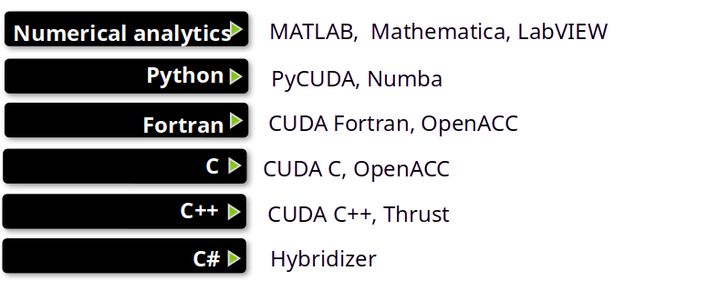
Programming Languages: Most Performance and Flexible Acceleration

Slide 16

What is CUDA?
CUDA Architecture
Compute Unified Device Architecture
Expose GPU parallelism for general-purpose computing
Retain performance
CUDA C/C++
Based on industry-standard C/C++
Small set of extensions to enable heterogeneous programming
Straightforward APIs to manage devices, memory etc.

Slide 17
Prerequisites to CUDA
You (probably) need experience with C or C++
You don’t need GPU experience
You don’t need parallel programming experience
You don’t need graphics experience

Slide 18
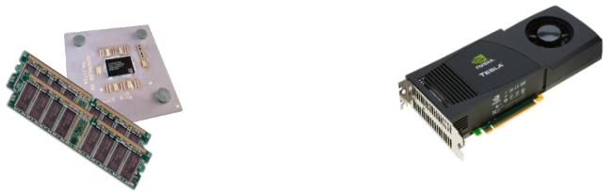
Heterogeneous Computing
Terminology:
Host The CPU and its memory (host memory)
Device The GPU and its memory (device memory)
HOST
DEVICE

Slide 19
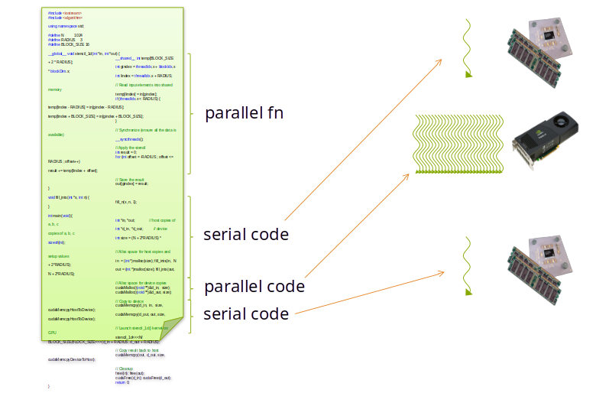
Heterogeneous Computing

Slide 20
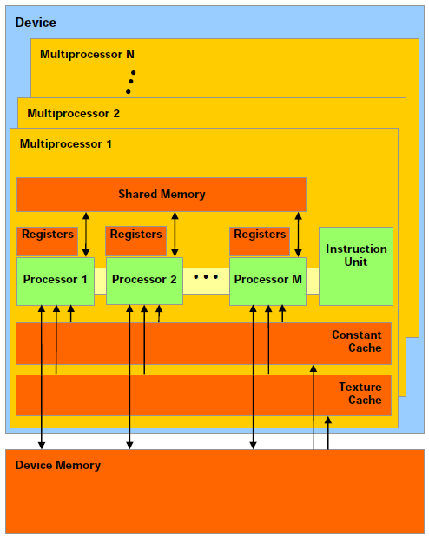
Nvidia GPU Architecture
A scalable array of multithreaded Streaming Multiprocessors (SMs), each SM consists of
Scalar Processor (SP) cores
A multithreaded instruction unit
On-chip shared memory
GDDR5 SDRAM
PCIe interface

Slide 21
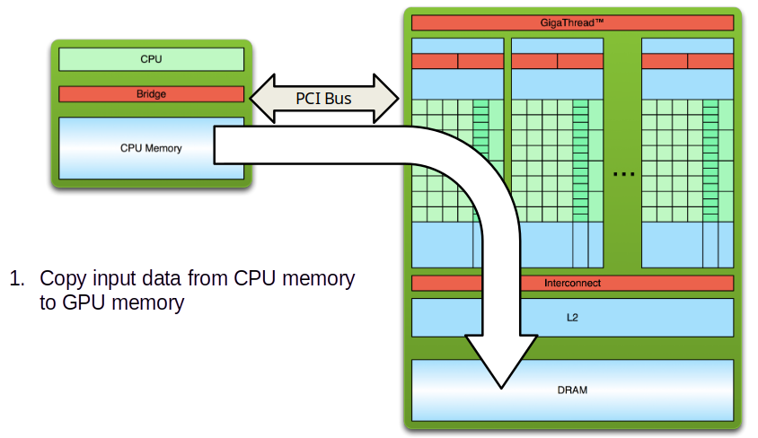
Simple Processing Flow

Slide 22
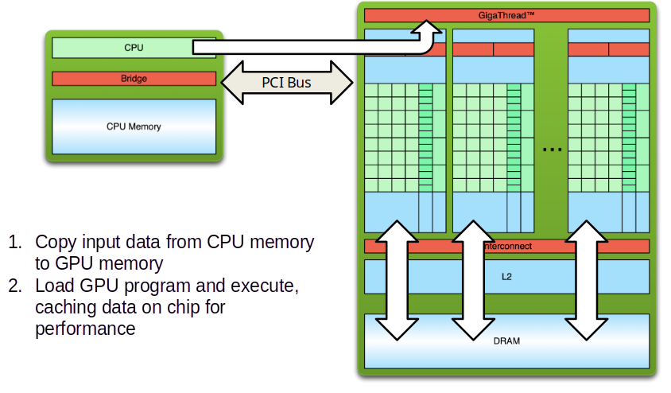
Simple Processing Flow

Slide 23
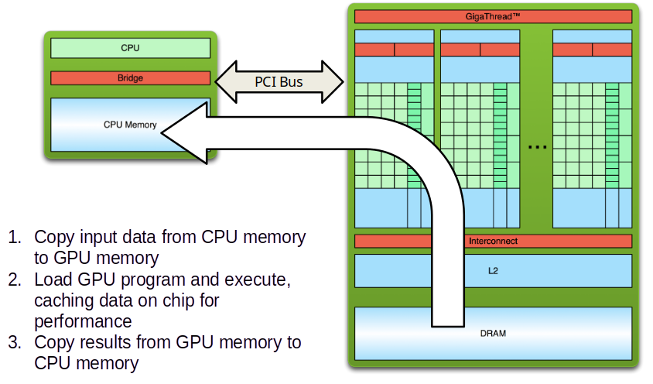
Simple Processing Flow

Slide 24
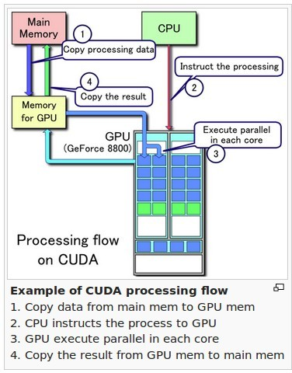
Simple Processing Flow
Source: Wikipedia
GPGPU Programming in CUDA | JBohara

Slide 25
Hello World!
int main(void) {
printf("Hello World!\n");
return 0;
}
Standard C that runs on the host
NVIDIA compiler (nvcc) can be used to compile programs with no device code
Output:
$ nvcc hello_world.cu
$ a.out
Hello World!
$

Slide 26
Hello World! with Device Code
__global__ void mykernel(void) {
}
int main(void) {
mykernel<<<1,1>>>();
printf("Hello World!\n");
return 0;
}
Two new syntactic elements…

Slide 27
Hello World! with Device Code
__global__ void mykernel(void) {
}
CUDA C/C++ keyword __global__ indicates a function that:
Runs on the device
Is called from host code
nvcc separates source code into host and device components
Device functions (e.g. mykernel()) processed by NVIDIA compiler
Host functions (e.g. main()) processed by standard host compiler
gcc, cl.exe

Slide 28
Hello World! with Device Code
mykernel<<<1,1>>>();
Triple angle brackets mark a call from host code to device code
Also called a “kernel launch”
We’ll return to the parameters (1,1) later
That’s all that is required to execute a function on the GPU!

Slide 29
Hello World! with Device Code
__global__ void mykernel(void){
}
int main(void) {
mykernel<<<1,1>>>();
printf("Hello World!\n");
return 0;
}
mykernel() does nothing, somewhat anticlimactic!
Output:
$ nvcc hello.cu
$ a.out
Hello World!
$

Slide 30
Parallel Programming in CUDA C/C++
But wait… GPU computing is about massive parallelism!
We need a more interesting example…
We’ll start by adding two integers and build up to vector addition
a
b
c

Slide 31
Data Parallelism - Vector Addition
vector A
A[0]
A[1]
A[2]
A[N-1]
…
vector B
B[0]
B[1]
B[2]
…
B[N-1]
+
+
+
+
vector C
C[0]
C[1]
C[2]
C[N-1]
…

Slide 32
Heterogeneous Computing vecAdd CUDA Host Code
Part 1
#include <cuda.h>
void vecAdd(float *h_A, float *h_B, float *h_C, int n)‏
{
int size = n* sizeof(float);
float *d_A, *d_B, *d_C;
// Part 1
// Allocate device memory for A, B, and C
// copy A and B to device memory
// Part 2
// Kernel launch code – the device performs the actual vector addition
// Part 3
// copy C from the device memory
// Free device vectors
}
Part 2
Host Memory
Device Memory
CPU
GPU
Part 3

Slide 33
Vector Addition – Traditional C Code
// Compute vector sum C = A + B
void vecAdd(float *h_A, float *h_B, float *h_C, int n)
{
int i;
for (i = 0; i<n; i++) h_C[i] = h_A[i] + h_B[i];
}
int main()
{
// Memory allocation for h_A, h_B, and h_C
// I/O to read h_A and h_B, N elements
…
vecAdd(h_A, h_B, h_C, N);
}

Slide 34
Addition on the Device
A simple kernel to add two integers
__global__ void add(int *a, int *b, int *c) {
*c = *a + *b;
}
As before __global__ is a CUDA C/C++ keyword meaning
add() will execute on the device
add() will be called from the host

Slide 35
Addition on the Device
Note that we use pointers for the variables
__global__ void add(int *a, int *b, int *c) {
*c = *a + *b;
}
add() runs on the device, so a, b and c must point to device memory
We need to allocate memory on the GPU

Slide 36
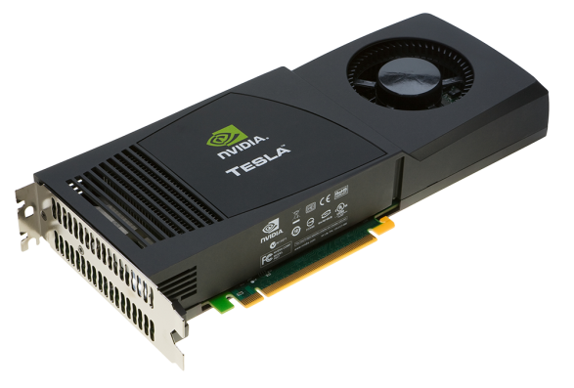
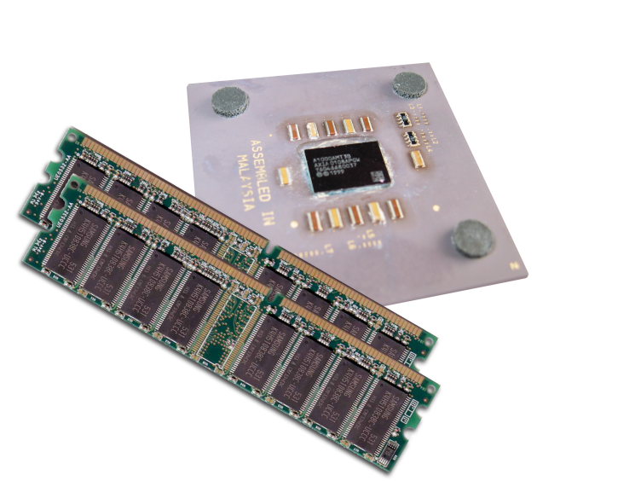
Memory Management
Host and device memory are separate entities
Device pointers point to GPU memory
May be passed to/from host code
May not be dereferenced in host code
Host pointers point to CPU memory
May be passed to/from device code
May not be dereferenced in device code
Simple CUDA API for handling device memory
cudaMalloc(), cudaFree(), cudaMemcpy()
Similar to the C equivalents malloc(), free(), memcpy()

Slide 37
Addition on the Device: add()
Returning to our add() kernel
__global__ void add(int *a, int *b, int *c) {
*c = *a + *b;
}
Let’s take a look at main()…

Slide 38
Addition on the Device: main()
int main(void) {
int a, b, c; // host copies of a, b, c
int *d_a, *d_b, *d_c; // device copies of a, b, c
int size = sizeof(int);
// Allocate space for device copies of a, b, c
cudaMalloc((void **)&d_a, size);
cudaMalloc((void **)&d_b, size);
cudaMalloc((void **)&d_c, size);
// Setup input values
a = 2;
b = 7;

Slide 39
Addition on the Device: main()
// Copy inputs to device
cudaMemcpy(d_a, &a, size, cudaMemcpyHostToDevice);
cudaMemcpy(d_b, &b, size, cudaMemcpyHostToDevice);
// Launch add() kernel on GPU
add<<<1,1>>>(d_a, d_b, d_c);
// Copy result back to host
cudaMemcpy(&c, d_c, size, cudaMemcpyDeviceToHost);
// Cleanup
cudaFree(d_a); cudaFree(d_b); cudaFree(d_c);
return 0;
}

Slide 40
Partial Overview of CUDA Memories
Device code can:
R/W per-thread registers
R/W all-shared global memory
Host code can
Transfer data to/from per grid global memory
(Device) Grid
Block (0, 0)
Block (0, 1)
Thread (0, 0)
Thread (0, 1)
Thread (0, 0)
Thread (0, 1)
Registers
Registers
Registers
Registers
Host
Global
Memory

Slide 41
CUDA Device Memory Management API functions
cudaMalloc()
Allocates an object in the device global memory
Two parameters
Address of a pointer to the allocated object
Size of allocated object in terms of bytes
cudaFree()
Frees object from device global memory
One parameter
Pointer to freed object
(Device) Grid
Block (0, 0)
Block (0, 1)
Thread (0, 0)
Thread (0, 1)
Thread (0, 0)
Thread (0, 1)
Registers
Registers
Registers
Registers
Host
Global
Memory

Slide 42
Host-Device Data Transfer API functions
cudaMemcpy()
memory data transfer
Requires four parameters
Pointer to destination
Pointer to source
Number of bytes copied
Type/Direction of transfer
Transfer to device is synchronous with respect to the host
(Device) Grid
Block (0, 0)
Block (0, 1)
Thread (0, 0)
Thread (0, 1)
Thread (0, 0)
Thread (0, 1)
Registers
Registers
Registers
Registers
Host
Global
Memory

Slide 43
CUDA Execution Model
Heterogeneous host (CPU) + device (GPU) application C program
Serial parts in host C code
Parallel parts in device SPMD kernel code
Serial Code (host)‏
Parallel Kernel (device)‏
KernelA<<< nBlk, nTid >>>(args);
. . .
Serial Code (host)‏
Parallel Kernel (device)‏
KernelB<<< nBlk, nTid >>>(args);
. . .

Slide 44
Arrays of Parallel Threads
A CUDA kernel is executed by a grid (array) of threads
All threads in a grid run the same kernel code (Single Program Multiple Data)‏
Each thread has indexes that it uses to compute memory addresses and make control decisions
0
1
2
254
255
…
i = blockIdx.x * blockDim.x + threadIdx.x;
C[i] = A[i] + B[i];
…

Slide 45
Thread Blocks: Scalable Cooperation
Thread Block 0
Thread Block 1
Thread Block N-1
0
1
2
254
255
0
1
2
254
255
0
1
2
254
255
…
…
…
i = blockIdx.x * blockDim.x + threadIdx.x;
C[i] = A[i] + B[i];
i = blockIdx.x * blockDim.x + threadIdx.x;
C[i] = A[i] + B[i];
i = blockIdx.x * blockDim.x + threadIdx.x;
C[i] = A[i] + B[i];
…
…
…
…
Divide thread array into multiple blocks
Threads within a block cooperate via shared memory, atomic operations and barrier synchronization
Threads in different blocks do not interact

Slide 46
blockIdx and threadIdx
Each thread uses indices to decide what data to work on
blockIdx: 1D, 2D, or 3D (CUDA 4.0)
threadIdx: 1D, 2D, or 3D
Simplifies memory addressing when processing multidimensional data
Image processing
Solving PDEs on volumes
…
device
Grid
Block (0, 0)
Block (0, 1)
Block (1, 0)
Block (1, 1)
Block (1,1)
(1,0,0)
(1,0,1)
(1,0,2)
(1,0,3)
Thread
(0,0,0)
Thread
(0,0,1)
Thread
(0,0,2)
Thread
(0,0,3)
‹#›
Thread
(0,0,0)
Thread
(0,1,3)
Thread
(0,1,0)
Thread
(0,1,1)
Thread
(0,1,2)

Slide 47
Example: Vector Addition Kernel Launch (Host Code)
Host Code
void vecAdd(float* h_A, float* h_B, float* h_C, int n)
{
// d_A, d_B, d_C allocations and copies omitted
// Run ceil(n/256.0) blocks of 256 threads each
vecAddKernel<<<ceil(n/256.0),256>>>(d_A, d_B, d_C, n);
}
The ceiling function makes sure that there are enough threads to cover all elements.

Slide 48
Example: Vector Addition Kernel
// Compute vector sum C = A + B
// Each thread performs one pair-wise addition
__global__
void vecAddKernel(float* A, float* B, float* C, int n)
{
int i = threadIdx.x+blockDim.x*blockIdx.x;
if(i<n) C[i] = A[i] + B[i];
}
Device Code

Slide 49
More on Kernel Launch (Host Code)
Host Code
void vecAdd(float* h_A, float* h_B, float* h_C, int n)
{
dim3 DimGrid((n-1)/256 + 1, 1, 1);
dim3 DimBlock(256, 1, 1);
vecAddKernel<<<DimGrid,DimBlock>>>(d_A, d_B, d_C, n);
}
This is an equivalent way to express the ceiling function.

Slide 50
Kernel execution in a nutshell
__host__
void vecAdd(…)
{
dim3 DimGrid(ceil(n/256.0),1,1);
dim3 DimBlock(256,1,1);
vecAddKernel<<<DimGrid,DimBlock>>>(d_A,d_B,d_C,n);
}
__global__
void vecAddKernel(float *A,
float *B, float *C, int n)
{
int i = blockIdx.x * blockDim.x
+ threadIdx.x;
if( i<n ) C[i] = A[i]+B[i];
}
Blk 0
Grid
Blk N-1
• • •
GPU
M0
• • •
Mk
RAM

Slide 51
More on CUDA Function Declaration
Executed on the:
Only callable from the:
__device__ float DeviceFunc()‏
device
device
__global__ void KernelFunc()‏
device
host
__host__ float HostFunc()‏
host
host
__global__ defines a kernel function
Each “__” consists of two underscore characters
A kernel function must return void
__device__ and __host__ can be used together
__host__ is optional if used alone

Slide 52
Compiling A CUDA Program
Integrated C programs with CUDA extensions
Run Command:
$ nvcc hello.cu
$ a.out
NVCC Compiler
Host Code
Device Code (PTX)
Host C Compiler/ Linker
Device Just-in-Time Compiler
Heterogeneous Computing Platform with
CPUs, GPUs, etc.

Slide 53
End of Lecture 8

